Slide 1
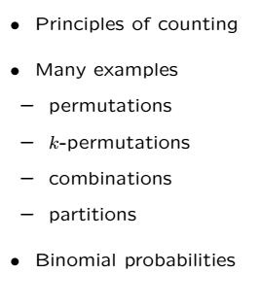
Counting!

Slide 2
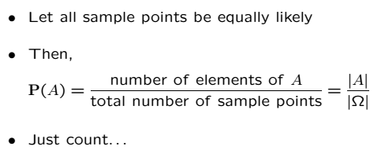
Discrete Uniform Law

Slide 3
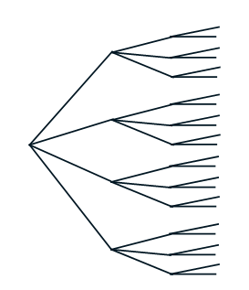
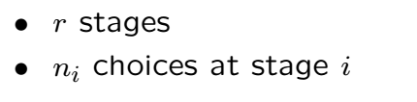
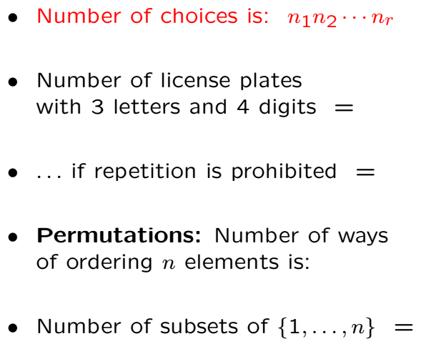
Basics

Slide 4
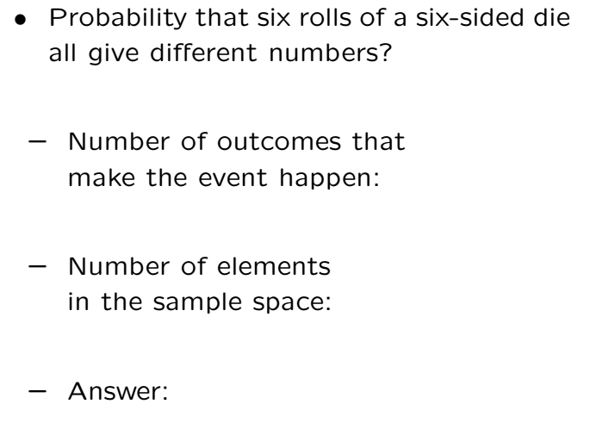
Example
0.0154
Don’t bet your money on it!

Slide 5
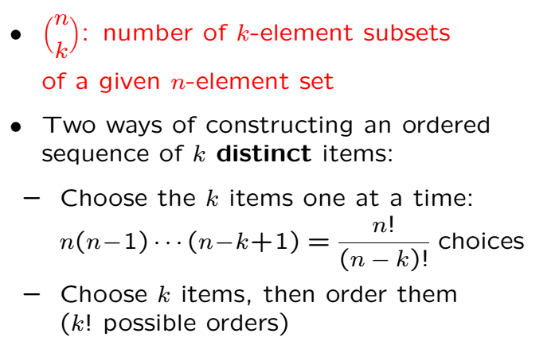
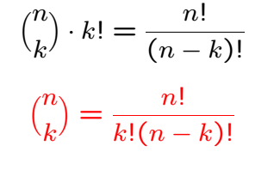
Combinations

Slide 6
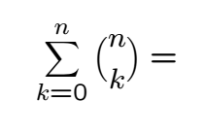

Sum of Combinations
Proof: Counting bit strings of length n
kth term of the sum = # of length n-bit strings with k ones
Both sides equal to total # of length n-bit strings

Slide 7
Examples
How many binary sequences of length 10 are there?
How many 4-letter “words” can letters A-Z produce?

Slide 8
Acknowledgements and Citations
Parts of these slides are adapted from the following resources:
Power Point Lecture Slides for the Textbook http://bcs.wiley.com/hebcs/Books?action=index&bcsId=8676&itemId=1118324560
John Tsitsiklis. 6.041 Probabilistic Systems Analysis and Applied Probability, Fall 2010. (Massachusetts Institute of Technology: MIT OpenCourseWare),http://ocw.mit.edu (Accessed 13 Apr, 2015). License: Creative Commons BY-NC-SA

